Slide 1
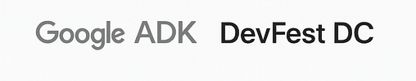
GovFlow: Reimagining Public Service
Notes:
“Imagine if applying for a business permit took minutes, not months. Hi, we’re the GovFlow team — and we’re building autonomous agents that modernize public service delivery.”

Slide 2

The Problem – Public Services Are Stuck in the Past.
Government processes move at the speed of paper.
Manual processes → Long waits → Lost trust
• 300M+ forms filed manually each year
• 4–12 week turnaround times
• $40–80 average handling cost per transaction
Notes:
“Today, most government requests — permits, records, benefits — still depend on manual workflows, legacy databases, and endless back-and-forth emails. Talking Points:
300M+ government forms processed manually every year.
Average permit or record request takes 4–12 weeks.
Cost per transaction: $40–80.
Citizens lose trust and time — agencies lose productivity.

Slide 3
The Solution — GovFlow Agent
GovFlow: Agentic AI for Public Service
AI Agents that Automate and Explain Government Decisions
• Built on Google ADK + Gemini for modular multi-agent orchestration.
• Automates 90% of form logic — keeps humans in control.
• Every rule check links to policy citations for full transparency.
Notes:
The Solution — GovFlow Agent
Key Headline: AI Agents that Automate and Explain Government Decisions
Visual: Diagram of the 7 agents — Intake → Validation → Policy Reasoner → Decision → Human Review → Comms → Audit.
Talking Points:
Built on Google’s Agent Development Kit (ADK) + Gemini AI Studio.
Handles end-to-end workflows — form intake, validation, policy checks, and decisions.
Human-in-the-loop transparency: every rule check links to the actual policy.
Reduces processing time from weeks to minutes.
Impact Metrics:
90% faster decision cycles.
70% lower cost per transaction.
100% auditability.

Slide 4
Impact Metrics
minutes not weeks, 70–90% lower handling cost, transparent by default.
Notes:
“Roll this to permits, benefits, FOIA — any repetitive gov workflow.”

Slide 5
The Vision — Scalable, Transparent Governance
Build once. Deploy everywhere.
Scalable, transparent, explainable public AI.
• Modular agent design deployable across city, state, and federal systems.
• Explainable by default — every decision justified.
• Citizens receive instant feedback via transparent status updates.
• Agencies gain analytics dashboards for throughput and equity.
Notes:
GovFlow is built on Google’s Agent Development Kit and Gemini — so it’s explainable, modular, and scalable. It can automate permits, FOIA requests, benefit claims — any repeatable process.
Our goal is to make government services as fast, transparent, and trustworthy as the best customer experience online.
Visual: Map of U.S. with nodes labeled “Permits,” “Benefits,” “FOIA,” “Licensing.”
Talking Points:
Modular design: same agent framework can power multiple departments.
Fully explainable: every decision has a rationale and policy citation.
Citizens get instant feedback, agencies get full transparency.
Future Vision:
Integrate real government datasets (Data.gov, state APIs).
Deploy multi-agent civic networks across local, state, and federal agencies.
Enable AI Public Service Infrastructure — faster, fairer, more accountable.
Tagline: “From bureaucracy to clarity — GovFlow is the future of public trust.”

Slide 6
The System
Architecture Overview
The GovFlow Agent Chain
Citizen → Intake Agent → Validation Agent → Policy Reasoner → Decision Drafter → Human Review → Comms → Audit → Citizen
Notes:
Architecture diagram (agents, RAG, human-in-the-loop, audit trail).
Stress ADK orchestration + Gemini reasoning + auditability.
GovFlow is built on Google’s Agent Development Kit and Gemini — so it’s explainable, modular, and scalable. It can automate permits, FOIA requests, benefit claims — any repeatable process. Our goal is to make government services as fast, transparent, and trustworthy as the best customer experience online.

Slide 7
Thank you
Join + Support Us
We’re turning bureaucracy into clarity — with Agentic AI for public good.
Notes:
“We’re turning bureaucracy into clarity — with Agentic AI for public good.”

Slide 8
The Problem – Public Services Are Stuck in the Past.
Key Headline: Government processes move at the speed of paper.
Visual: Split-screen of a citizen waiting in line vs. an AI agent approving forms.
Talking Points:
300M+ government forms processed manually every year.
Average permit or record request takes 4–12 weeks.
Cost per transaction: $40–80.
Citizens lose trust and time — agencies lose productivity.
Tagline: “We can make every public service feel like ordering a coffee online.”
Notes:
Government services are slow because each request takes humans hours of triage.
GovFlow Agent automates the boring 90%, keeps humans in control, and gives citizens instant transparency.
—-

Slide 9
The Solution — GovFlow Agent
Key Headline: AI Agents that Automate and Explain Government Decisions
Visual: Diagram of the 7 agents — Intake → Validation → Policy Reasoner → Decision → Human Review → Comms → Audit.
Talking Points:
Built on Google’s Agent Development Kit (ADK) + Gemini AI Studio.
Handles end-to-end workflows — form intake, validation, policy checks, and decisions.
Human-in-the-loop transparency: every rule check links to the actual policy.
Reduces processing time from weeks to minutes.
Impact Metrics:
90% faster decision cycles.
70% lower cost per transaction.
100% auditability.

Slide 10
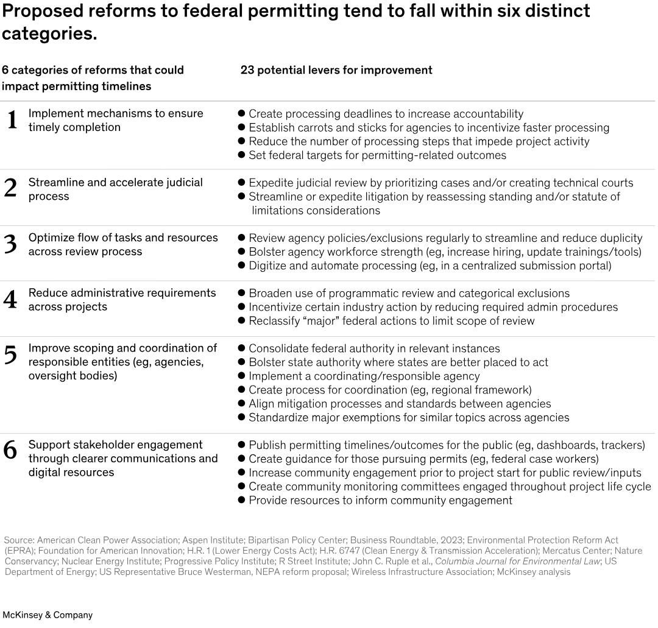

Slide 11
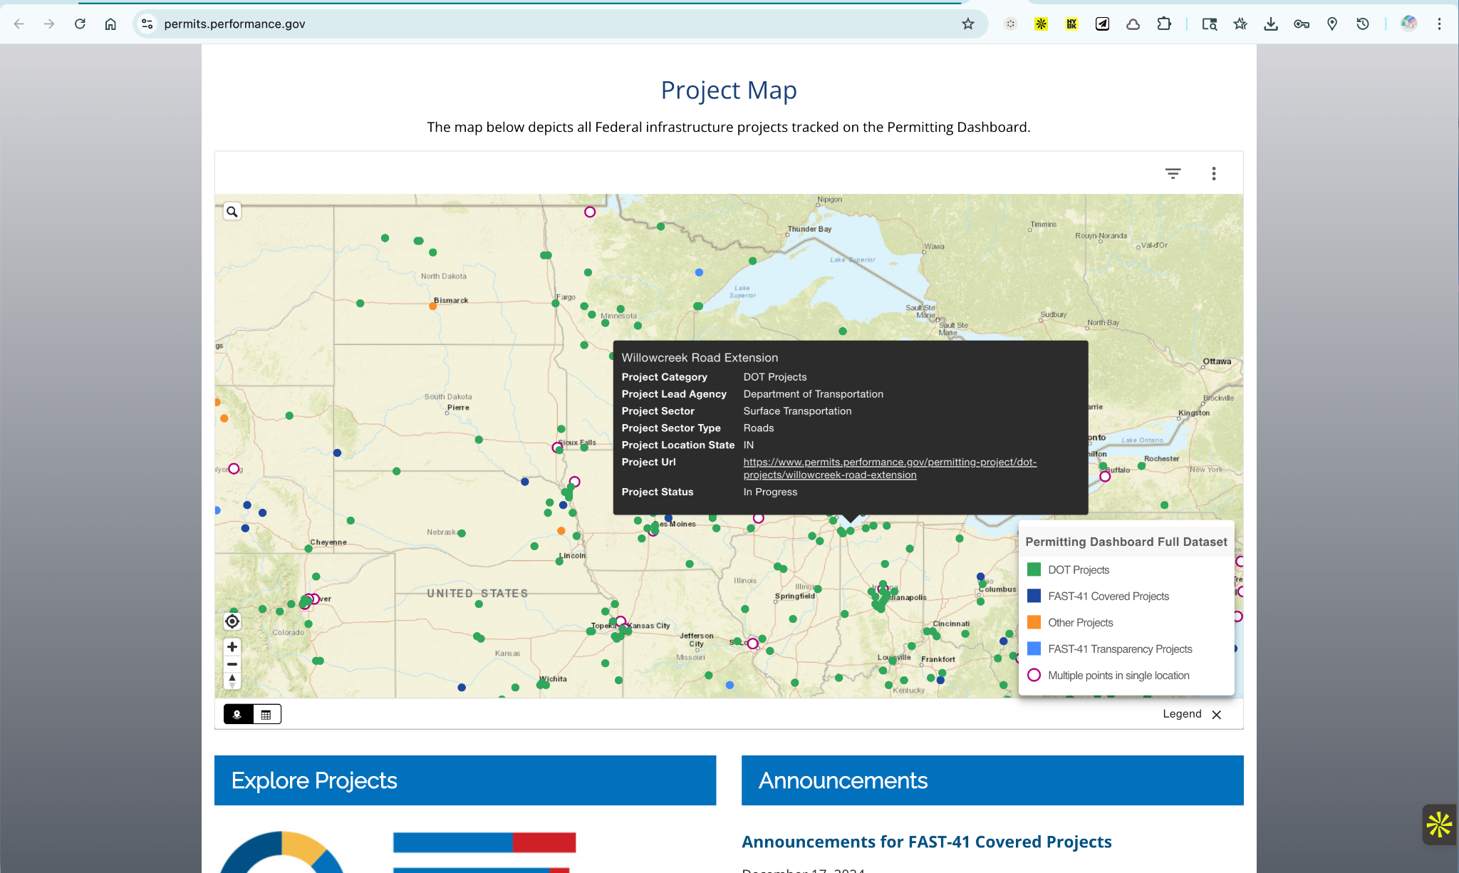
Notes:
From Permitting Performance
https://www.permits.performance.gov/

Slide 12
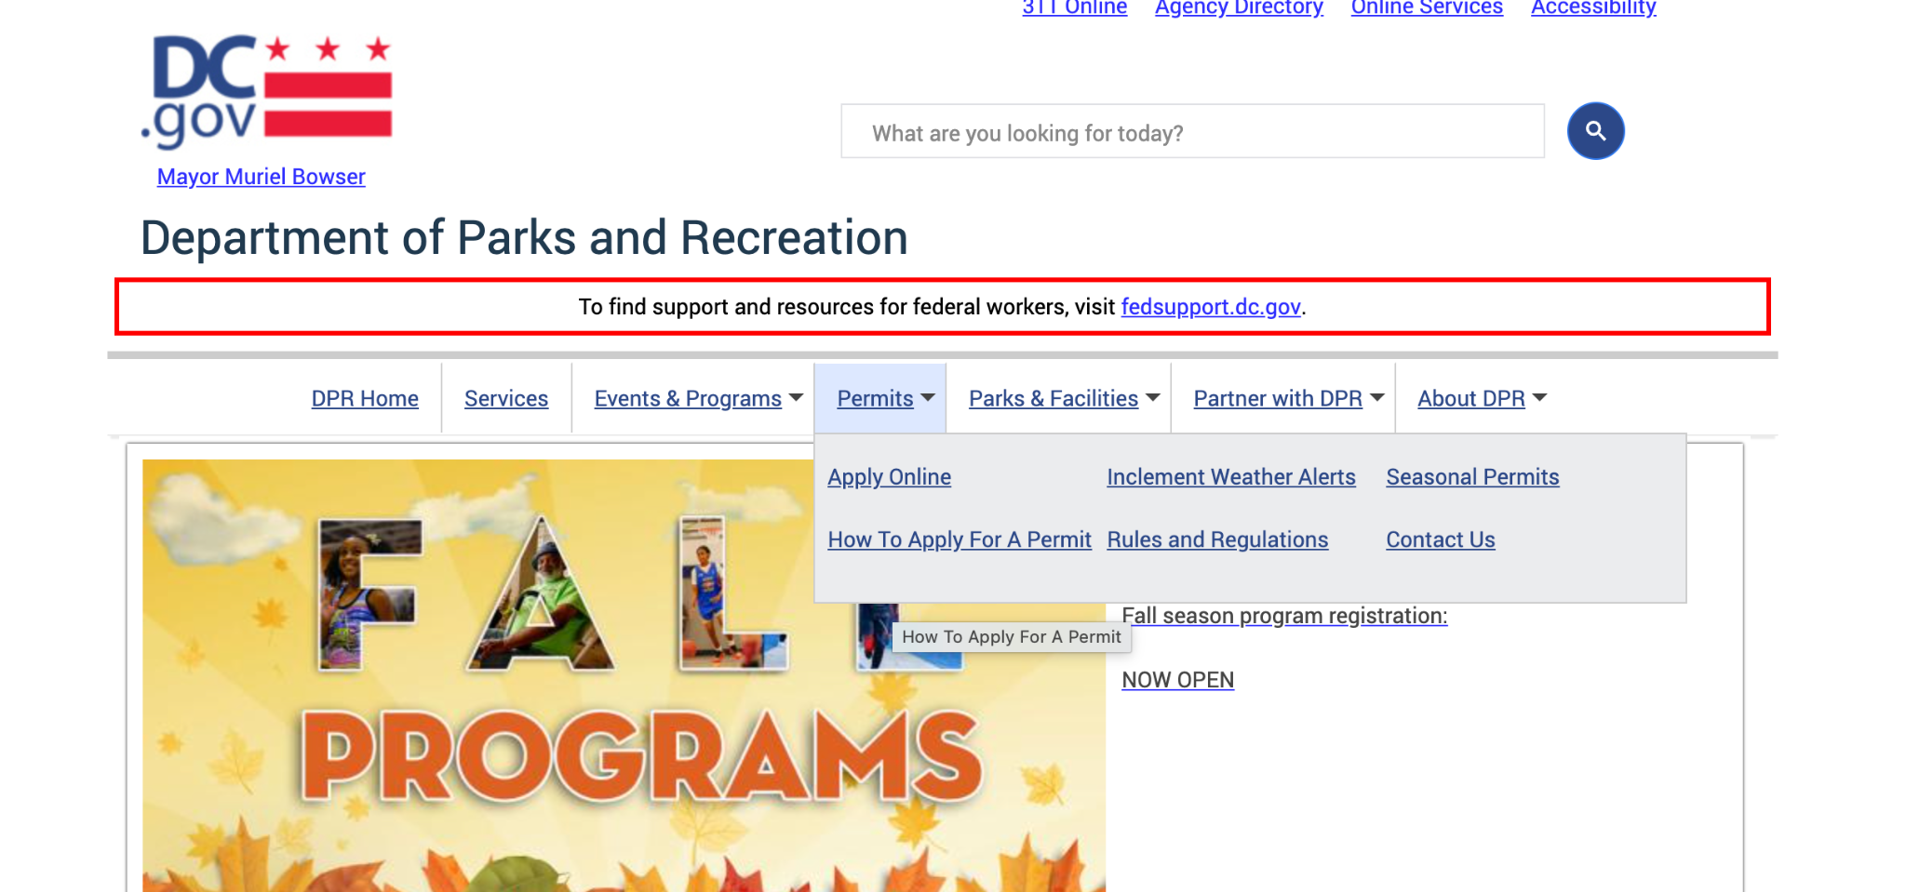
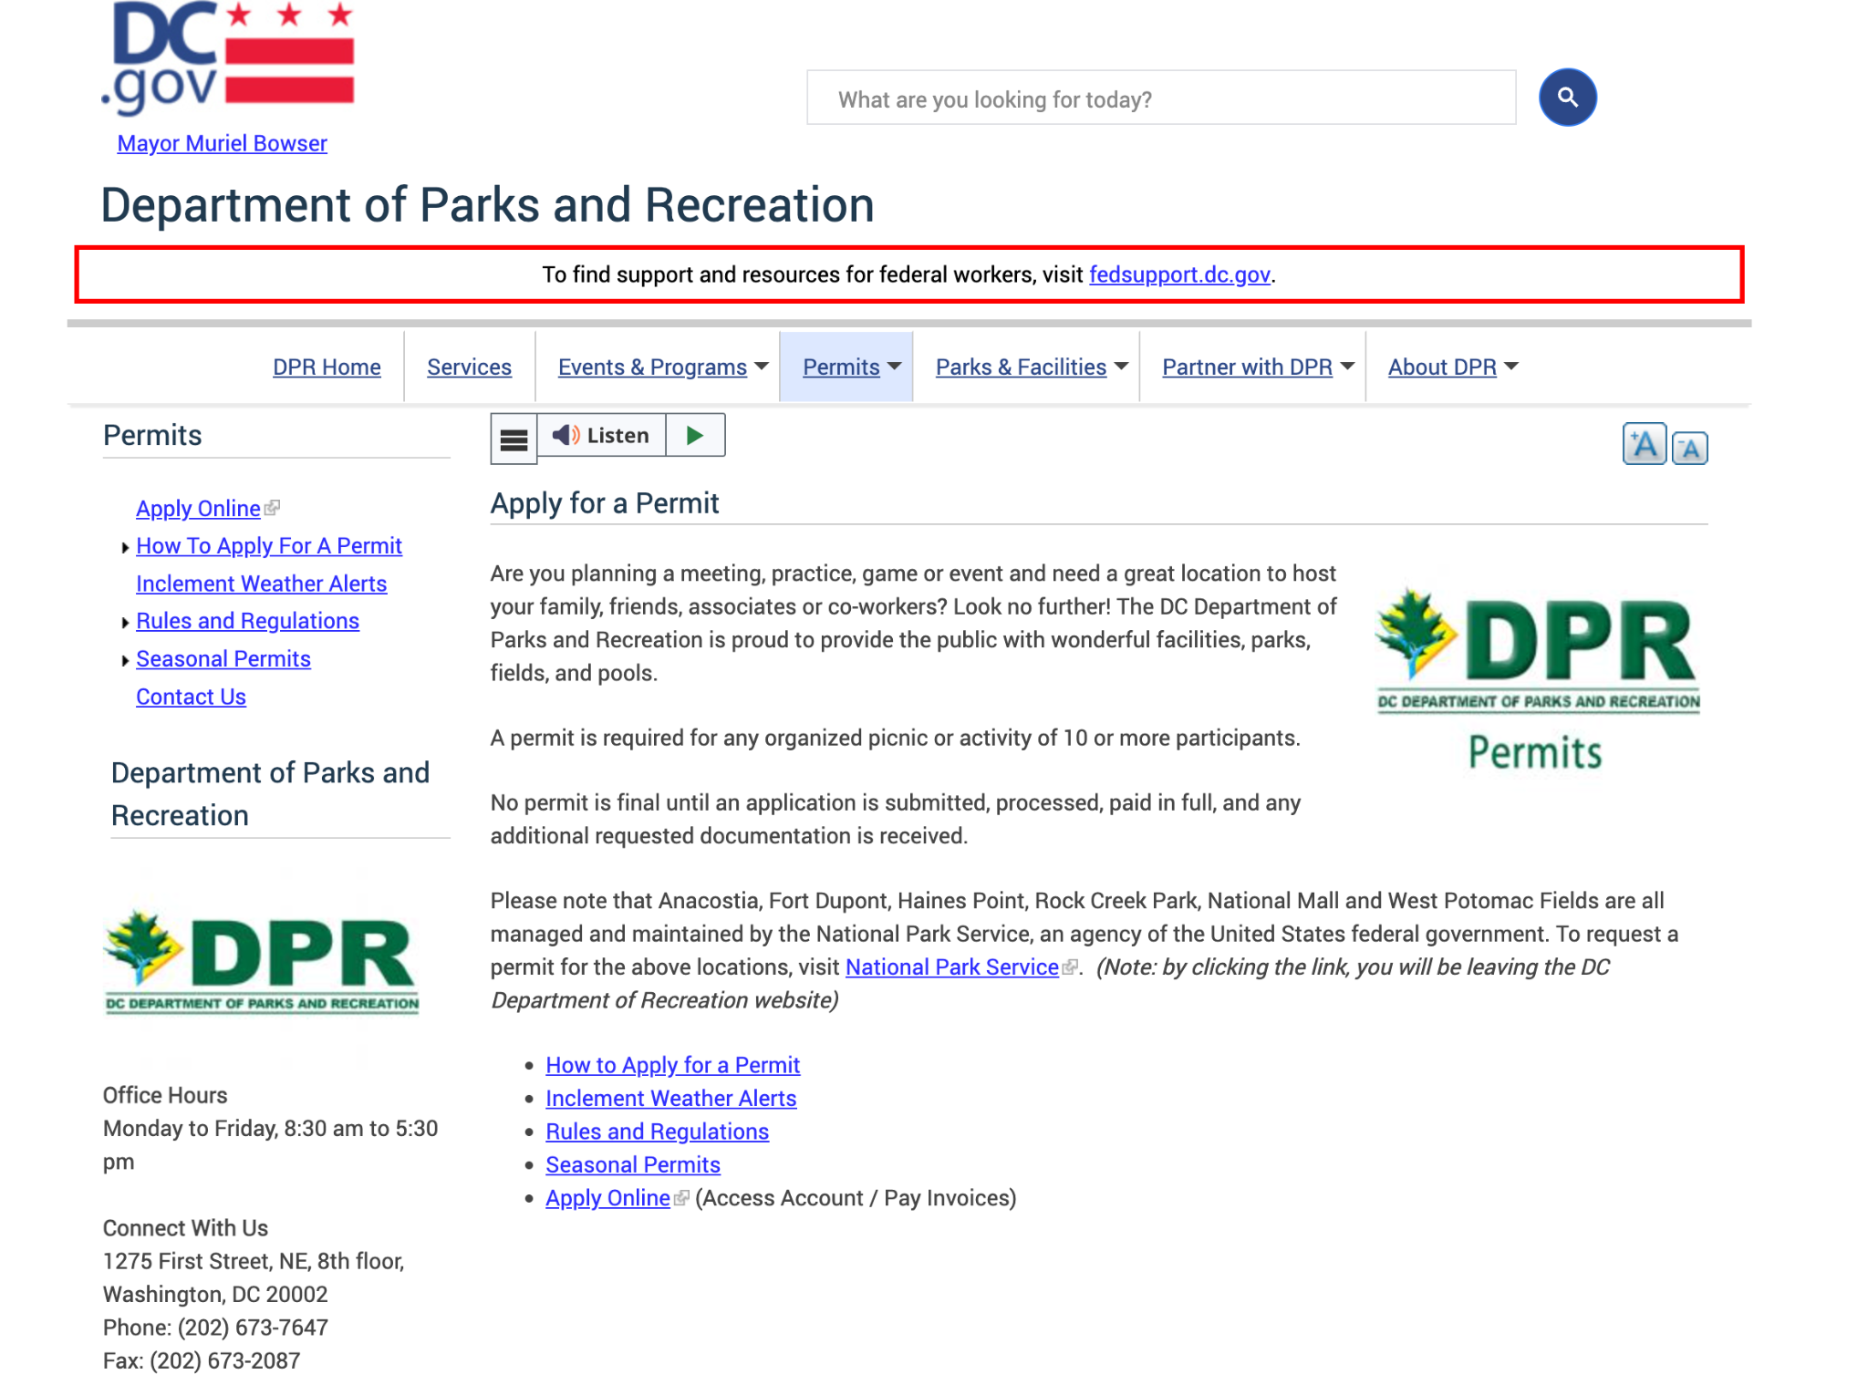
Notes:
https://dpr.dc.gov/permits

Slide 13
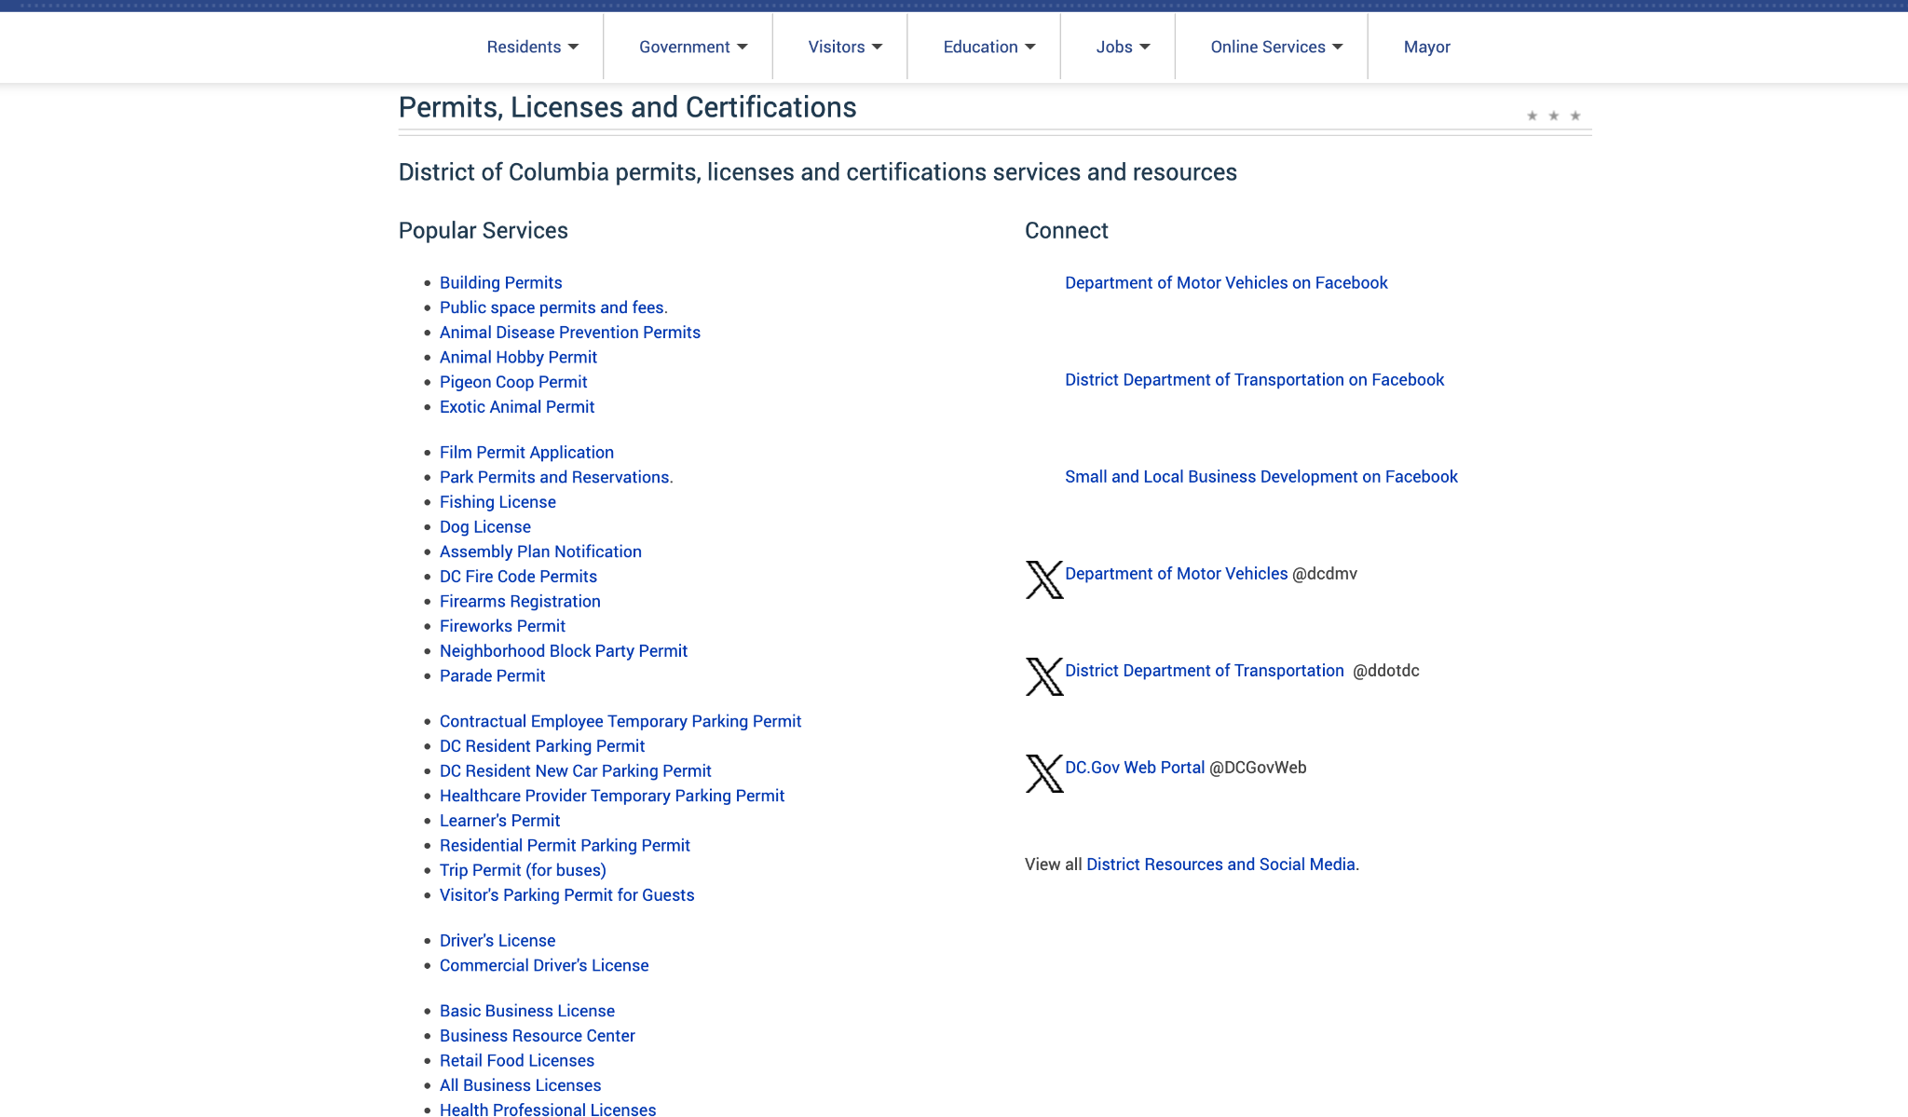
Notes:
Types of Permits and Licenses
https://dc.gov/page/permits-licenses-and-certifications

Slide 14
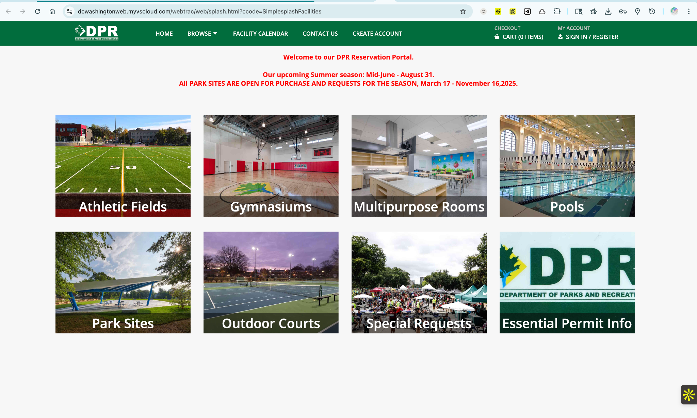
Notes:
Apply for a Permit - DC park
https://dcwashingtonweb.myvscloud.com/webtrac/web/splash.html?ccode=SimplesplashFacilities

Slide 15
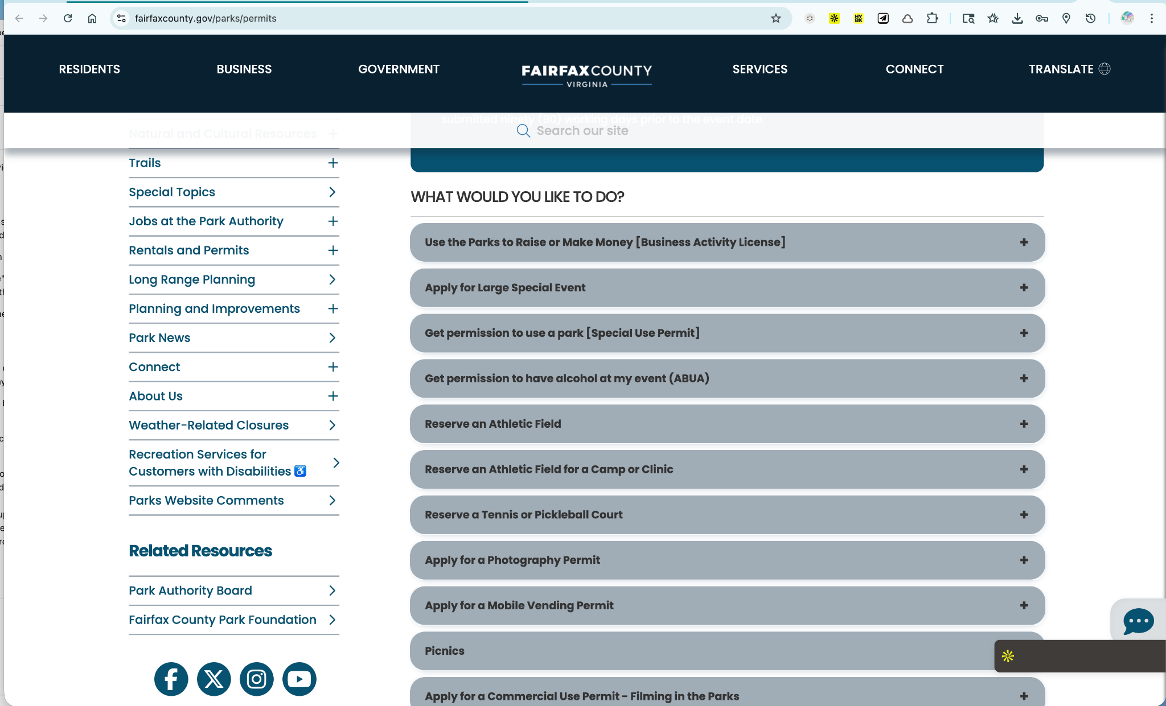
Notes:
Fairfax County Park Permits site
https://www.fairfaxcounty.gov/parks/permits

Slide 16
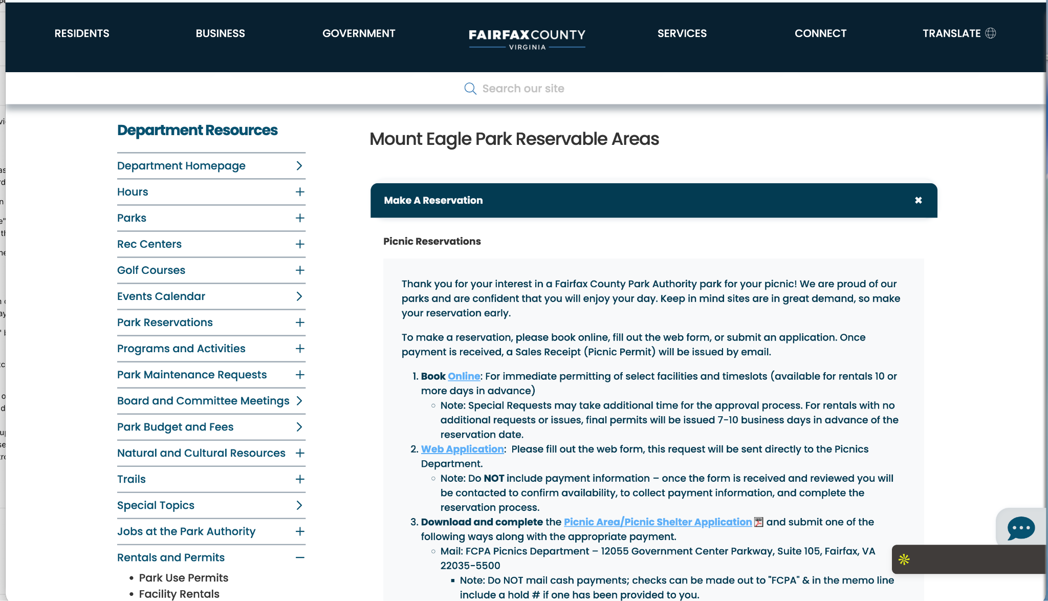
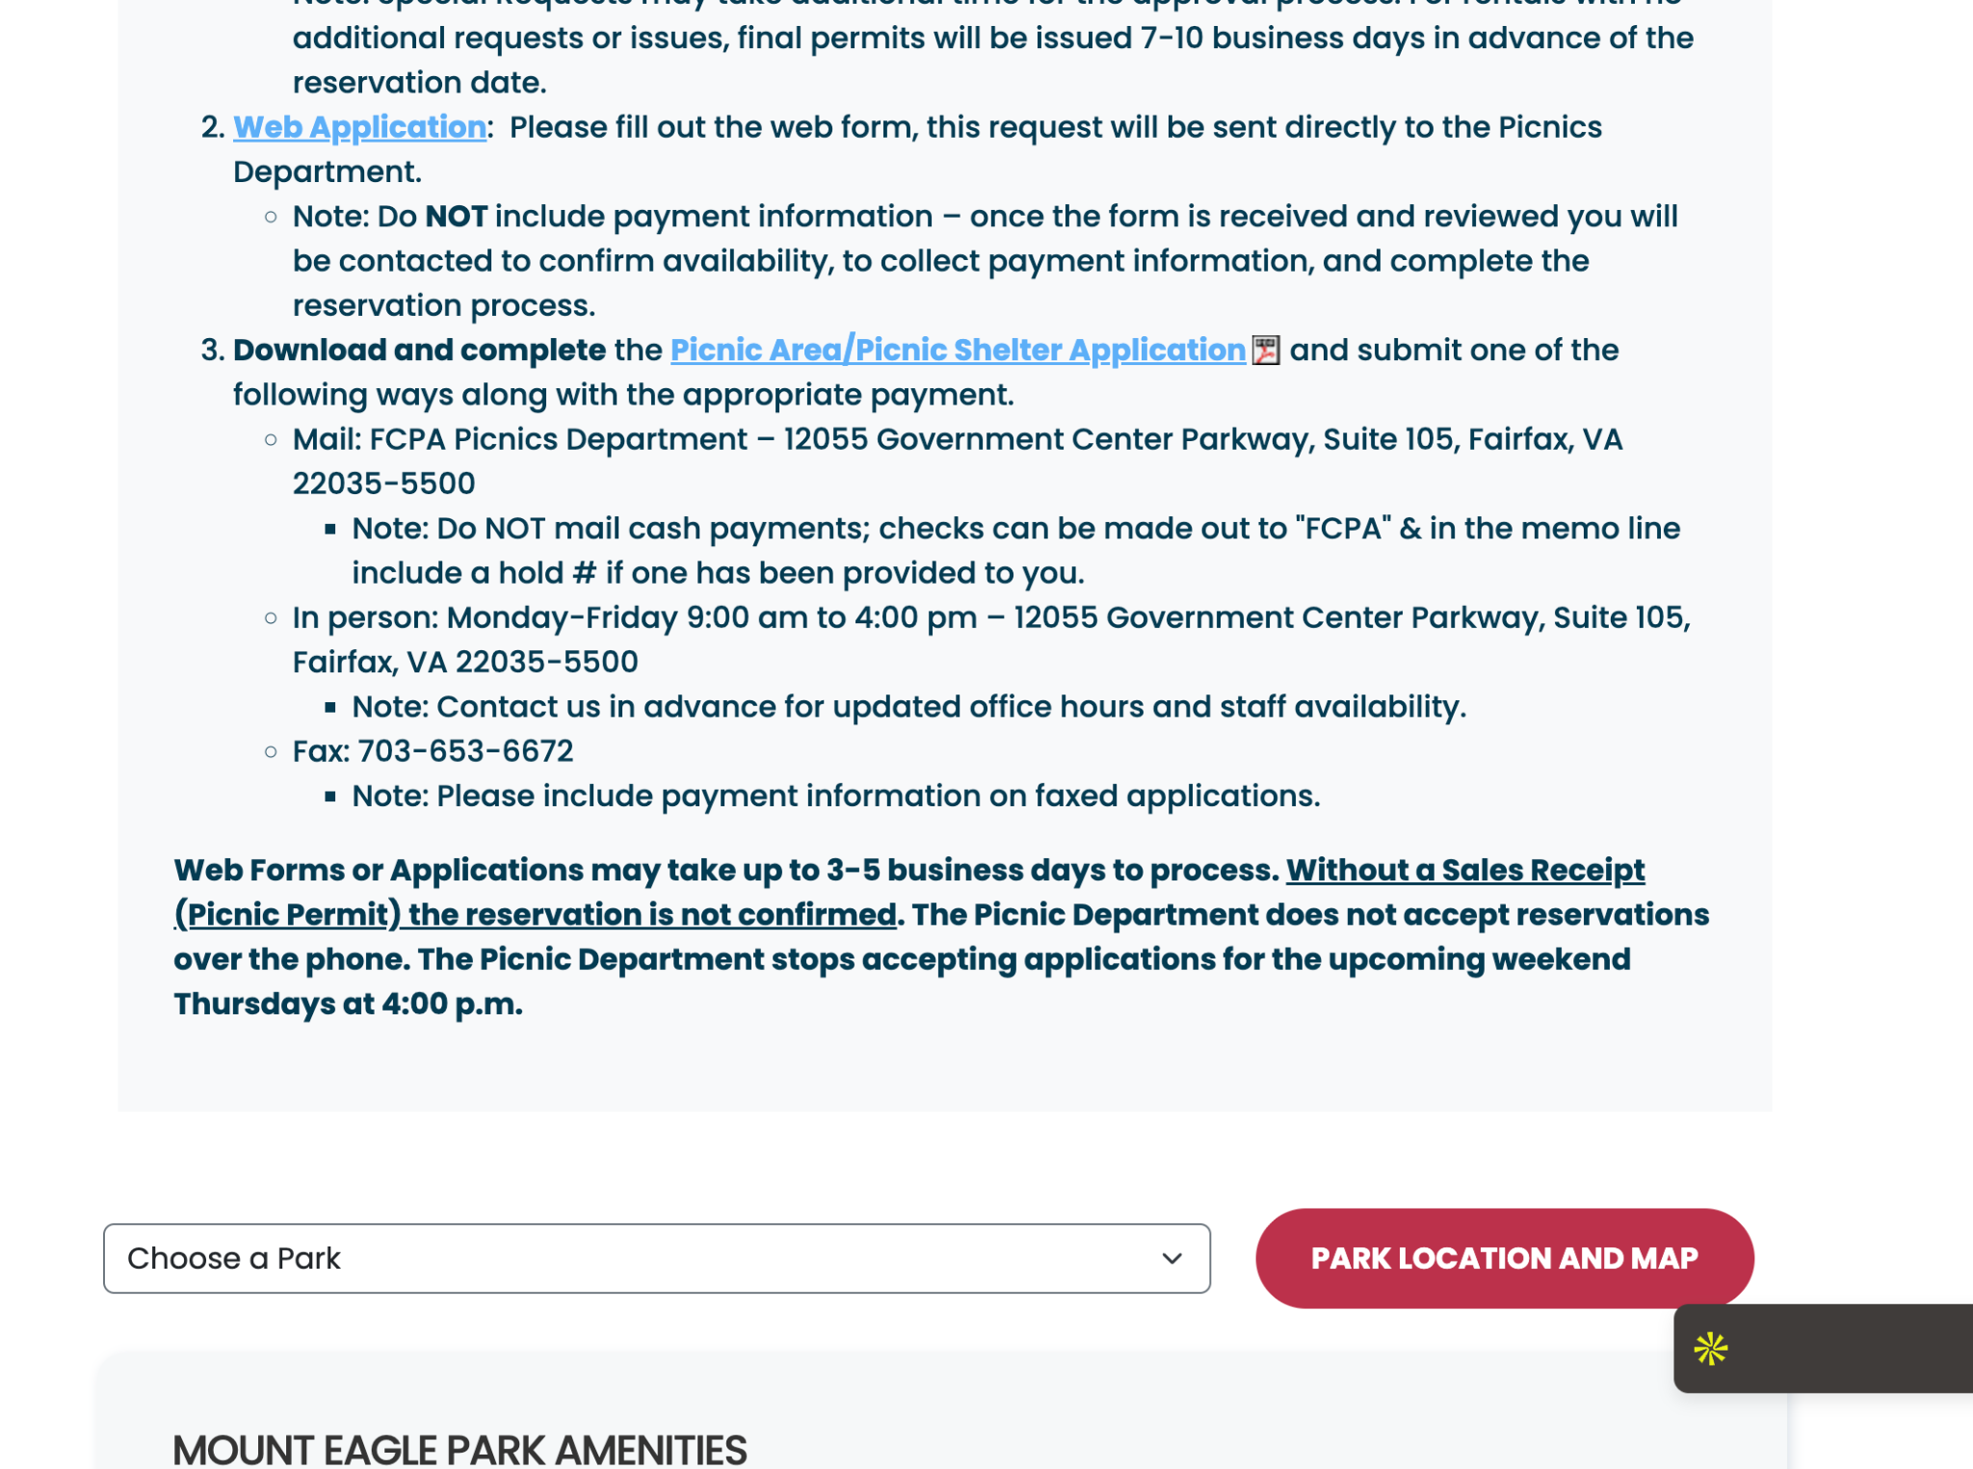
Notes:
How to reserve a picnic table in a park in Fairfax Virginia
https://www.fairfaxcounty.gov/parks/picnics/mount-eagle

Slide 17
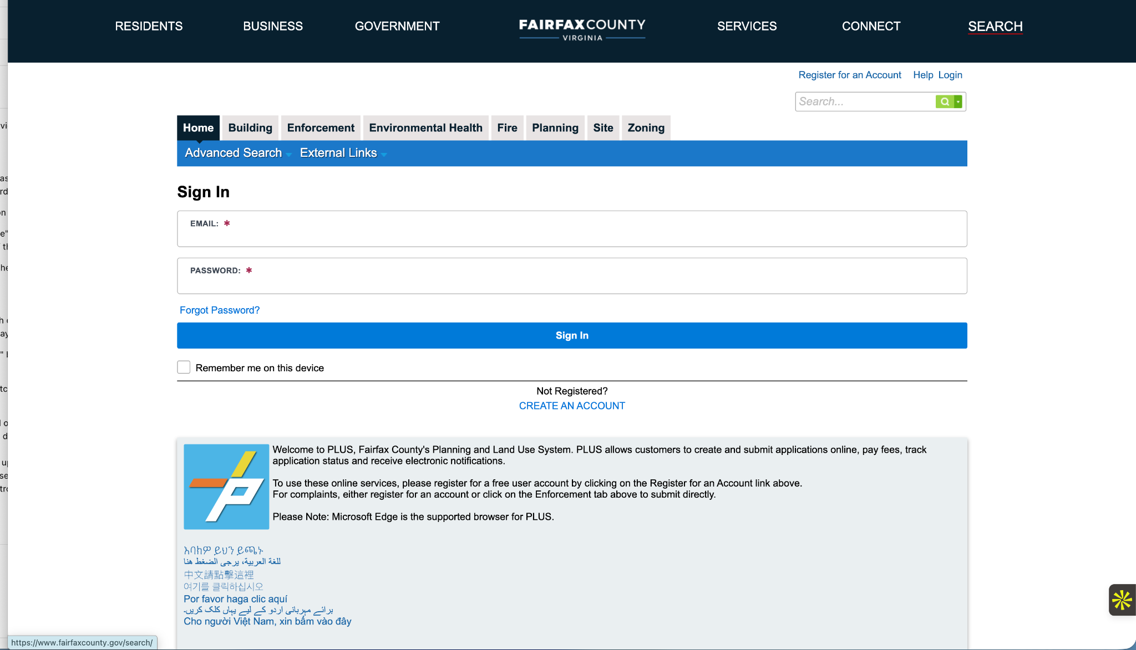
Notes:
Fairfax County uses “PLUS” (“Planning and Land Use System”)
http://plus.fairfaxcounty.gov/CitizenAccess/Welcome.aspx?TabName=Home&TabList=Home%7C0%7CBuilding%7C1%7CEnforcement%7C2%7CEnvHealth%7C3%7CFire%7C4%7CPlanning%7C5%7CSite%7C6%7CZoning%7C7%7CCurrentTabIndex%7C0

Slide 18
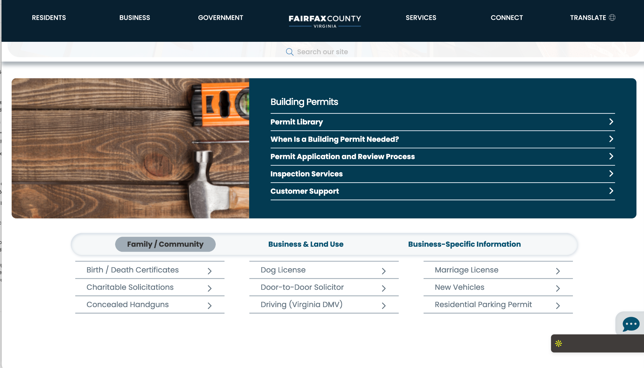
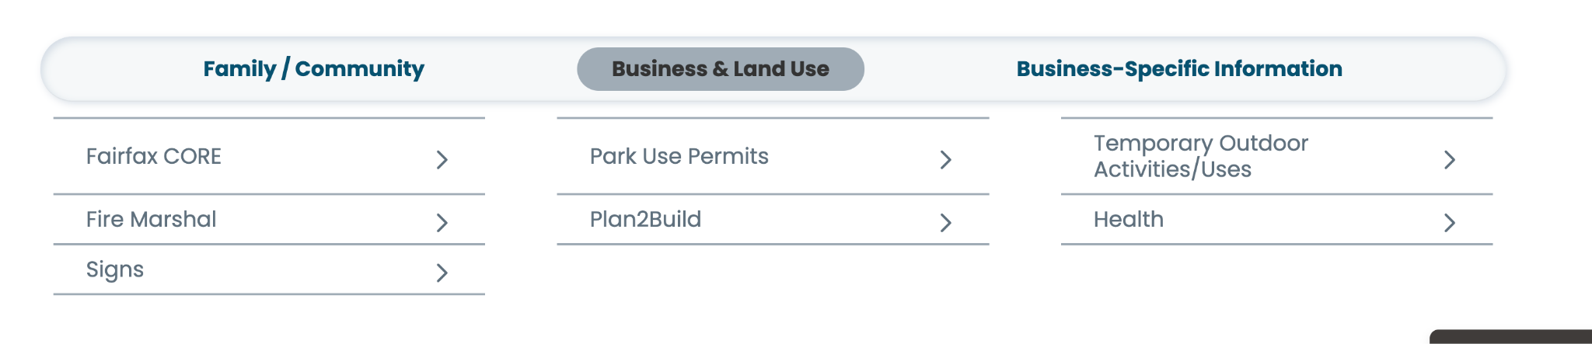
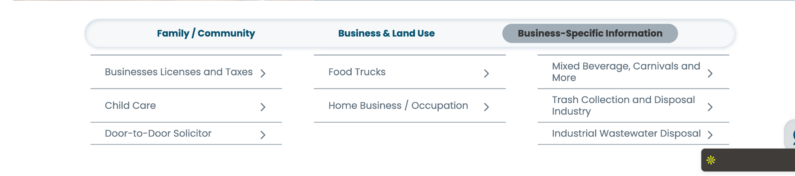
Notes:
Fairfax County Permits & Licenses page
https://www.fairfaxcounty.gov/topics/permits-and-licenses

Slide 19
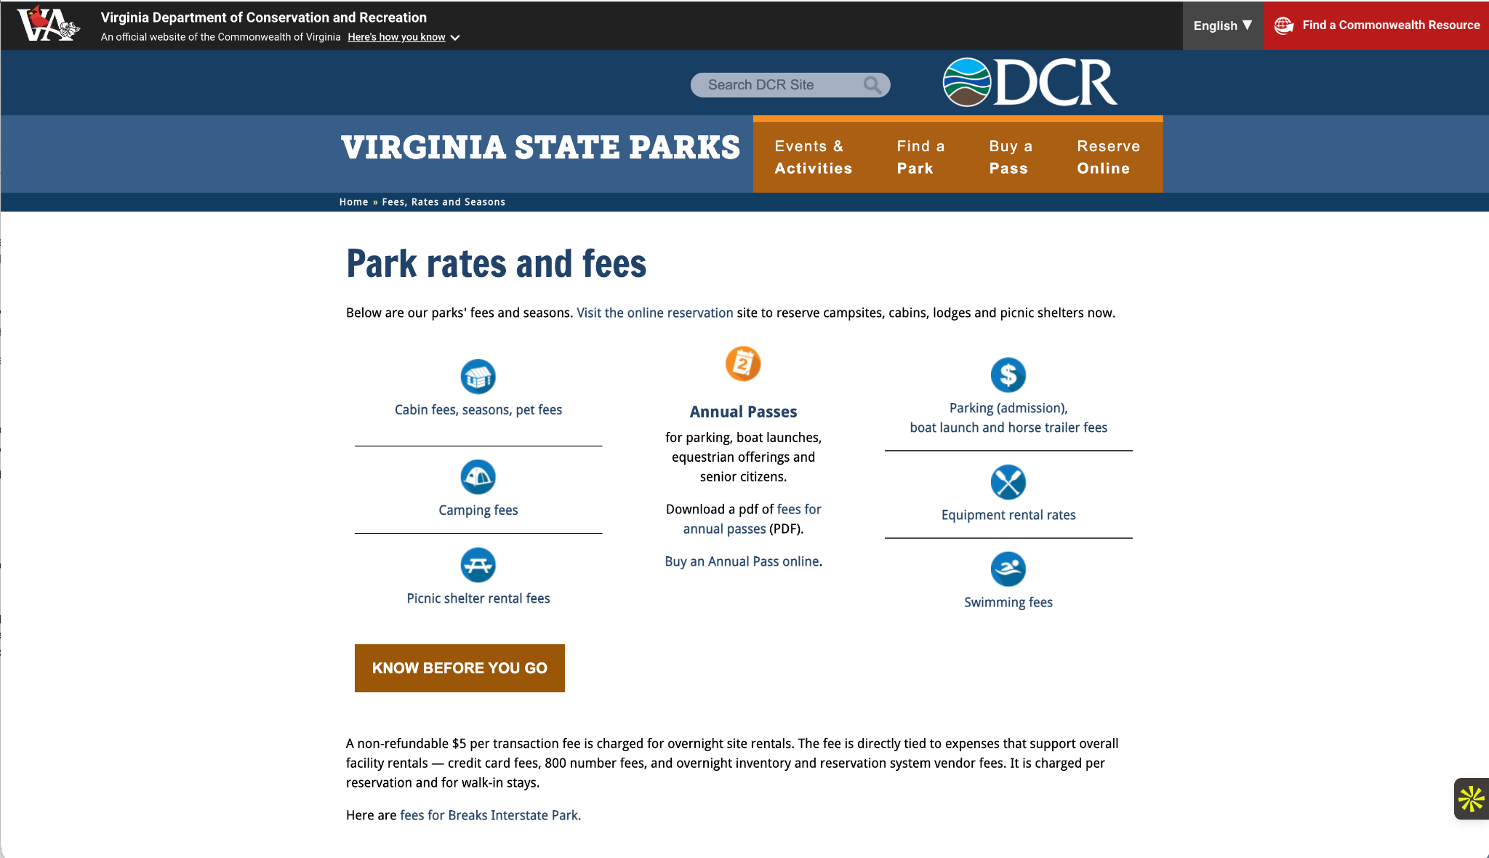
Notes:
How to reserve campsite, grilles, etc in Virginia State Parks - Park fee and rates
https://www.dcr.virginia.gov/state-parks/parkfees

Slide 20
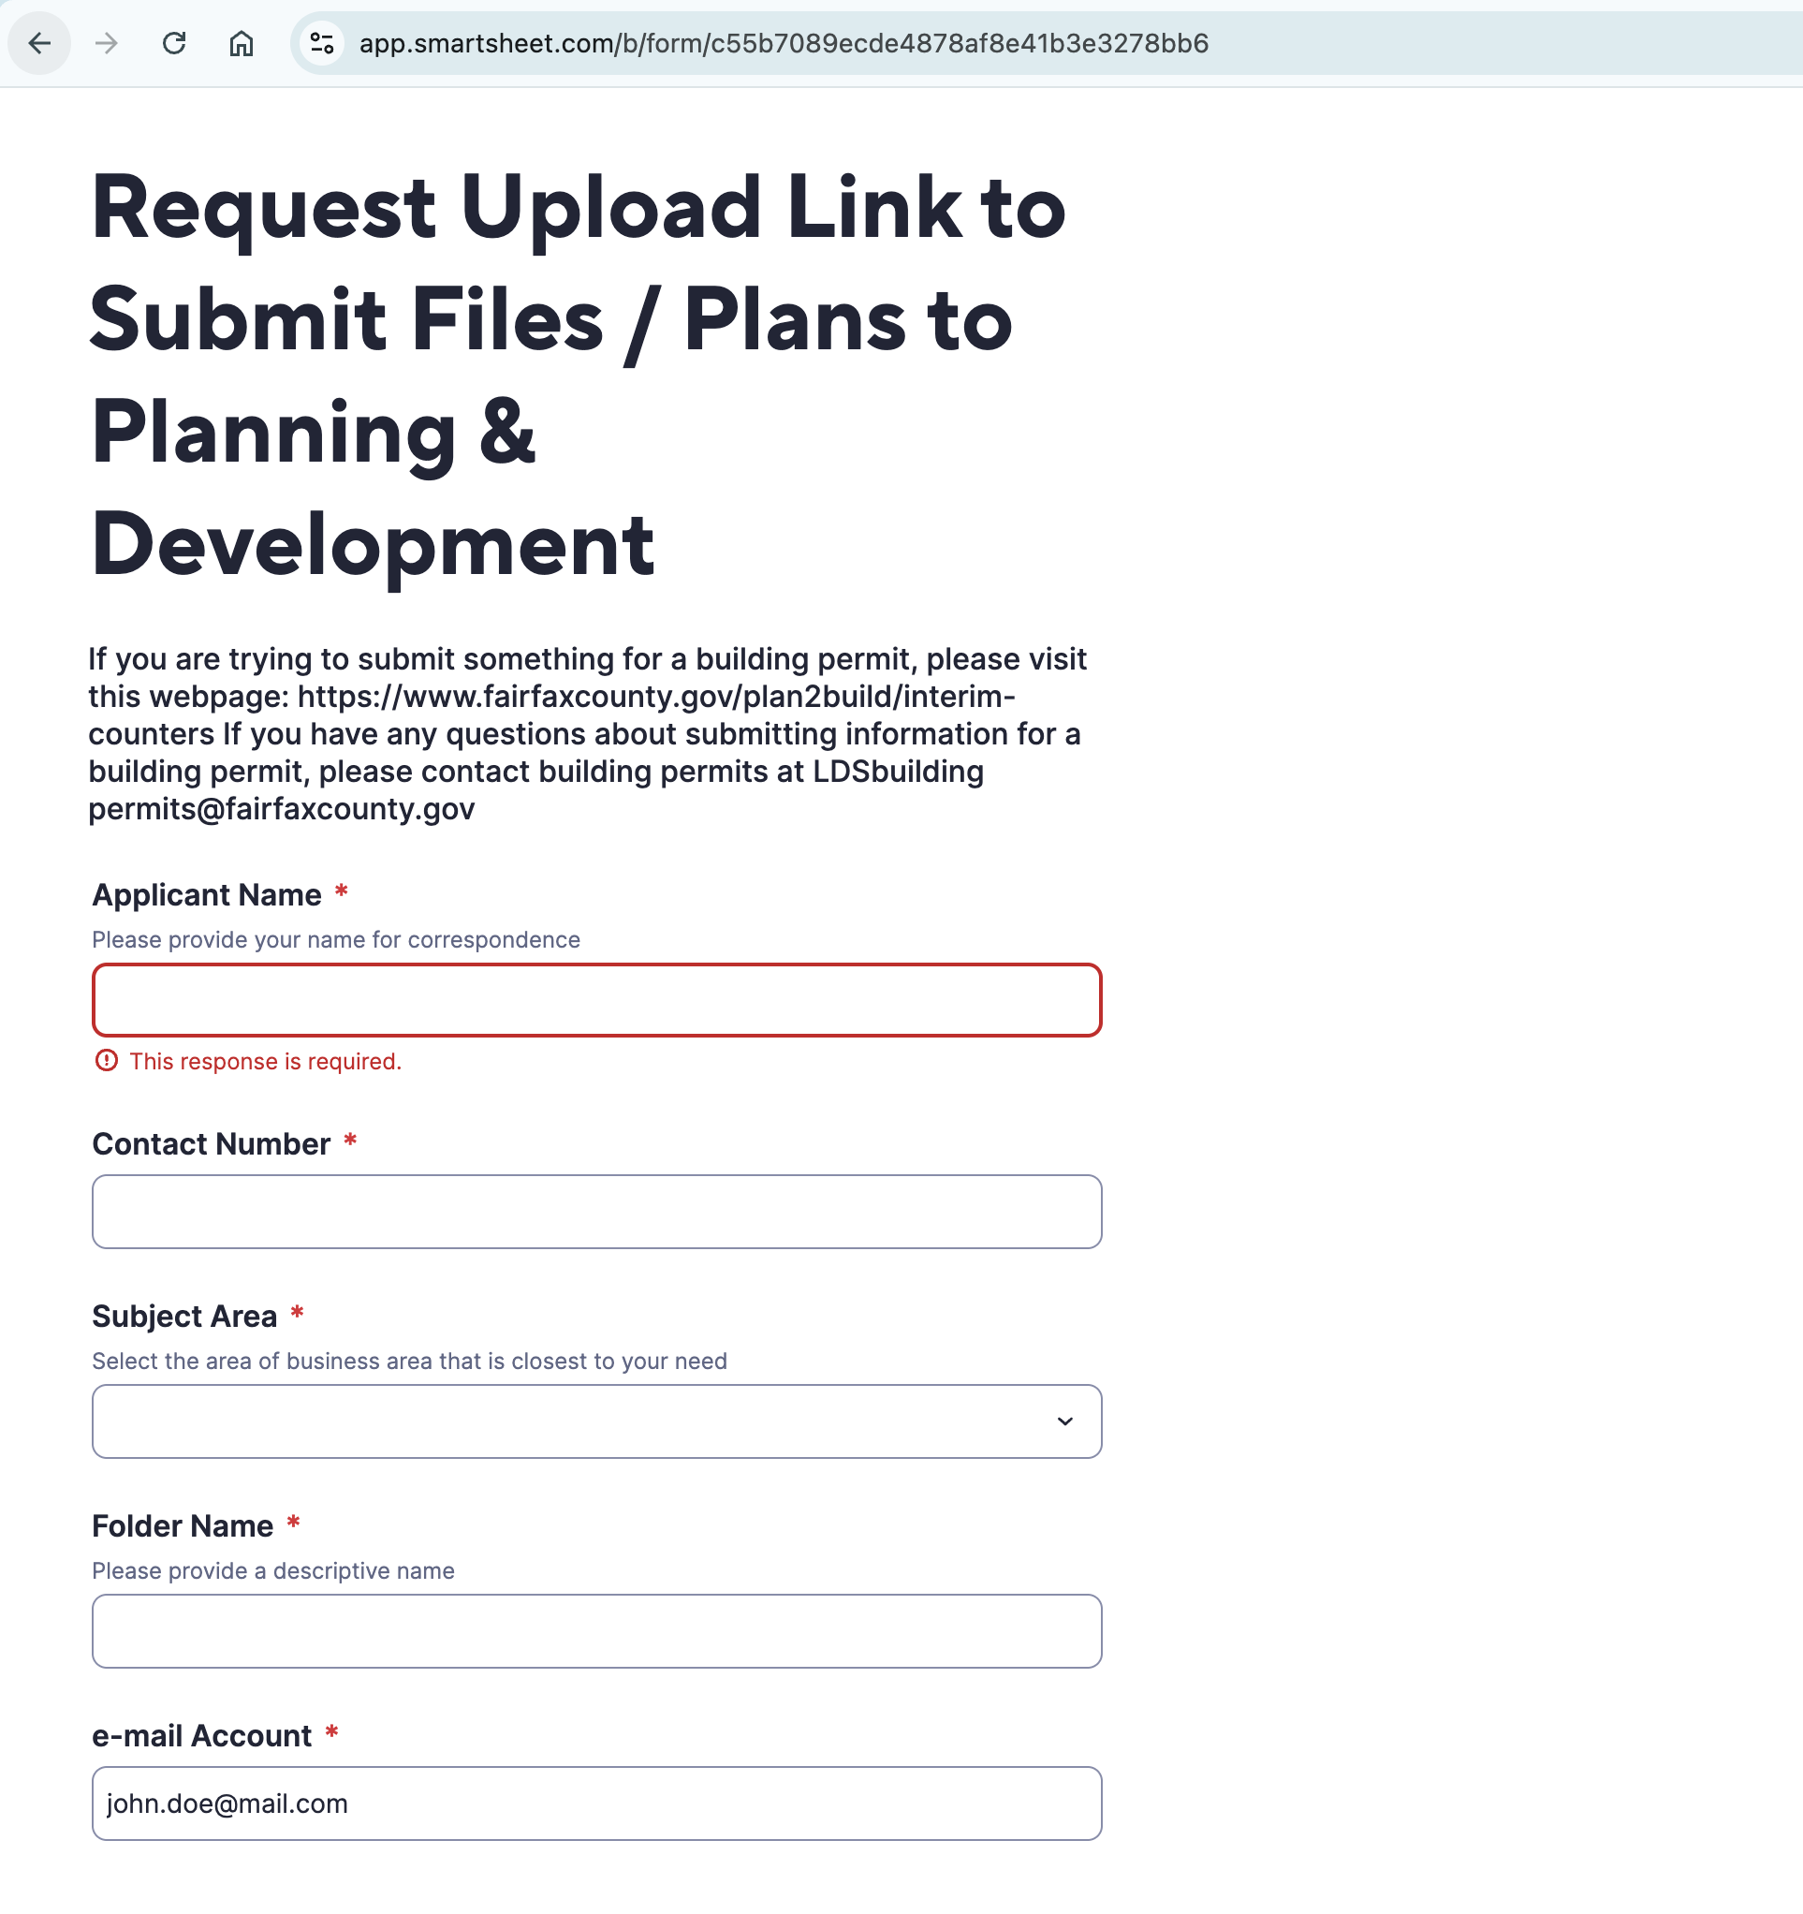
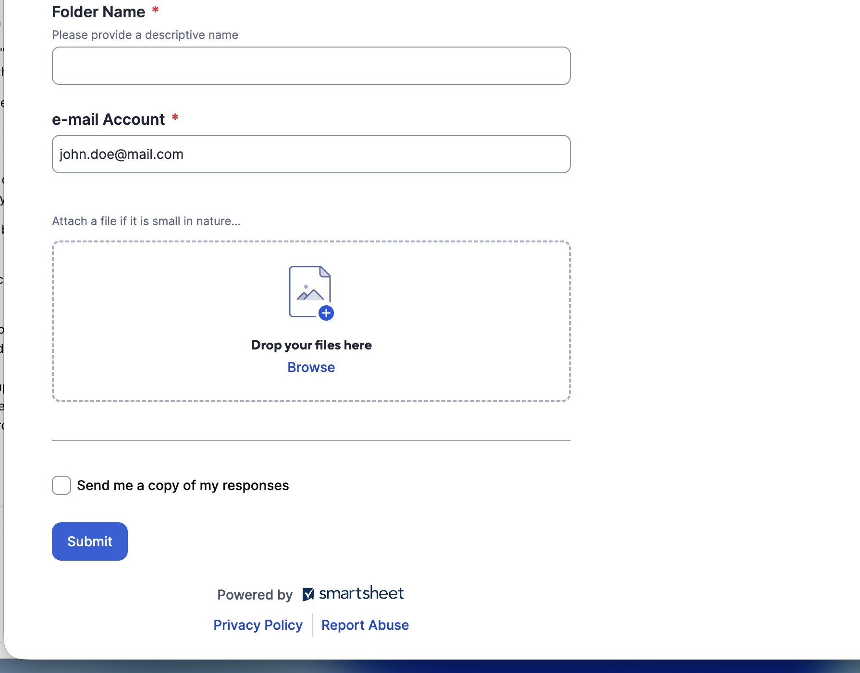
Notes:
Permit Submission form using Smartsheet form submission
https://app.smartsheet.com/b/form/c55b7089ecde4878af8e41b3e3278bb6

Slide 21
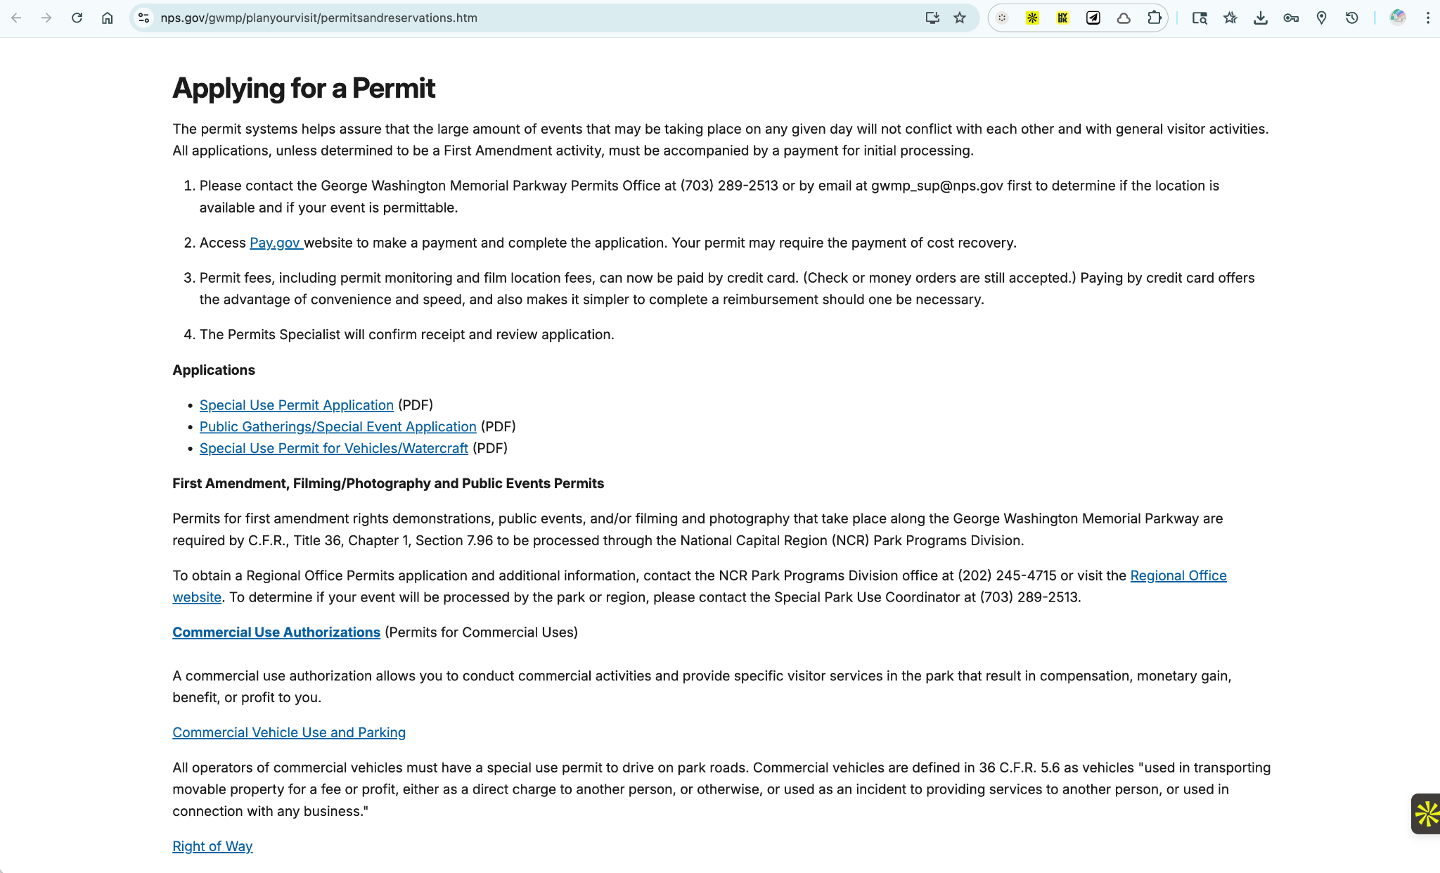
Notes:
Example of the Current Permit submission process
https://www.nps.gov/gwmp/planyourvisit/permitsandreservations.htm

